Slide 1
CREATE THREE INSTANCES AND ATTACH ONE EFS TO TWO INSTANCES AND ATTACH ONE EBS TO ONE INSTANCE

Slide 2
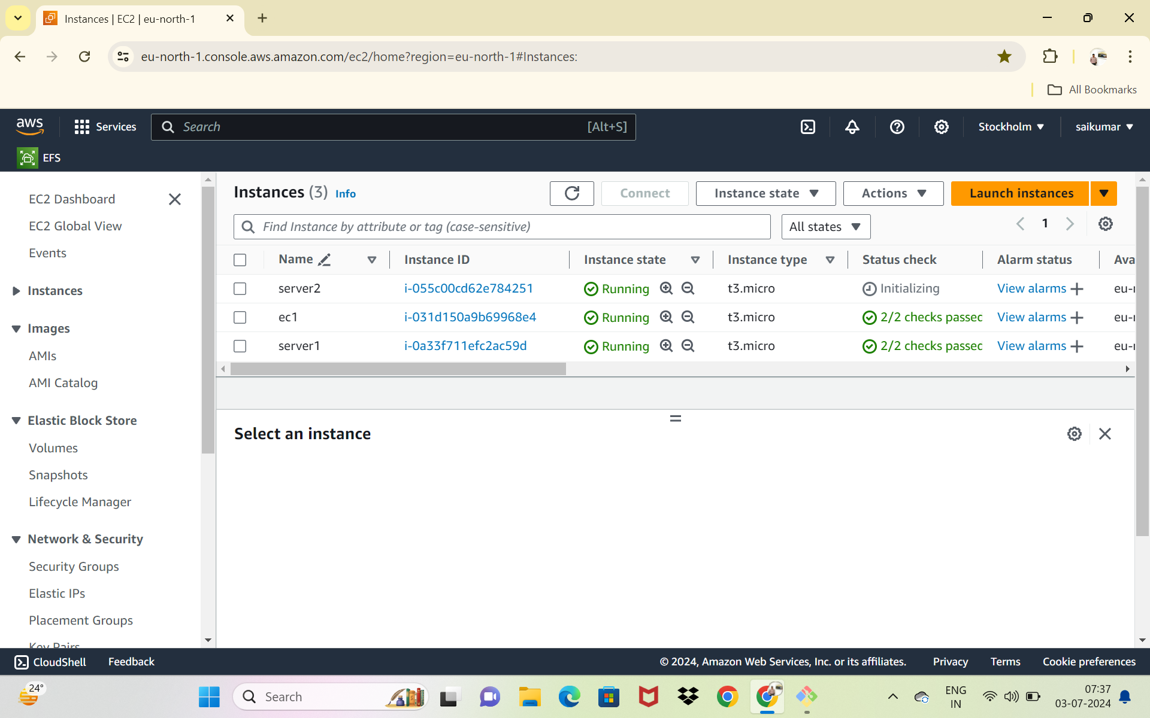
CREATE THREE INSTANCES

Slide 3
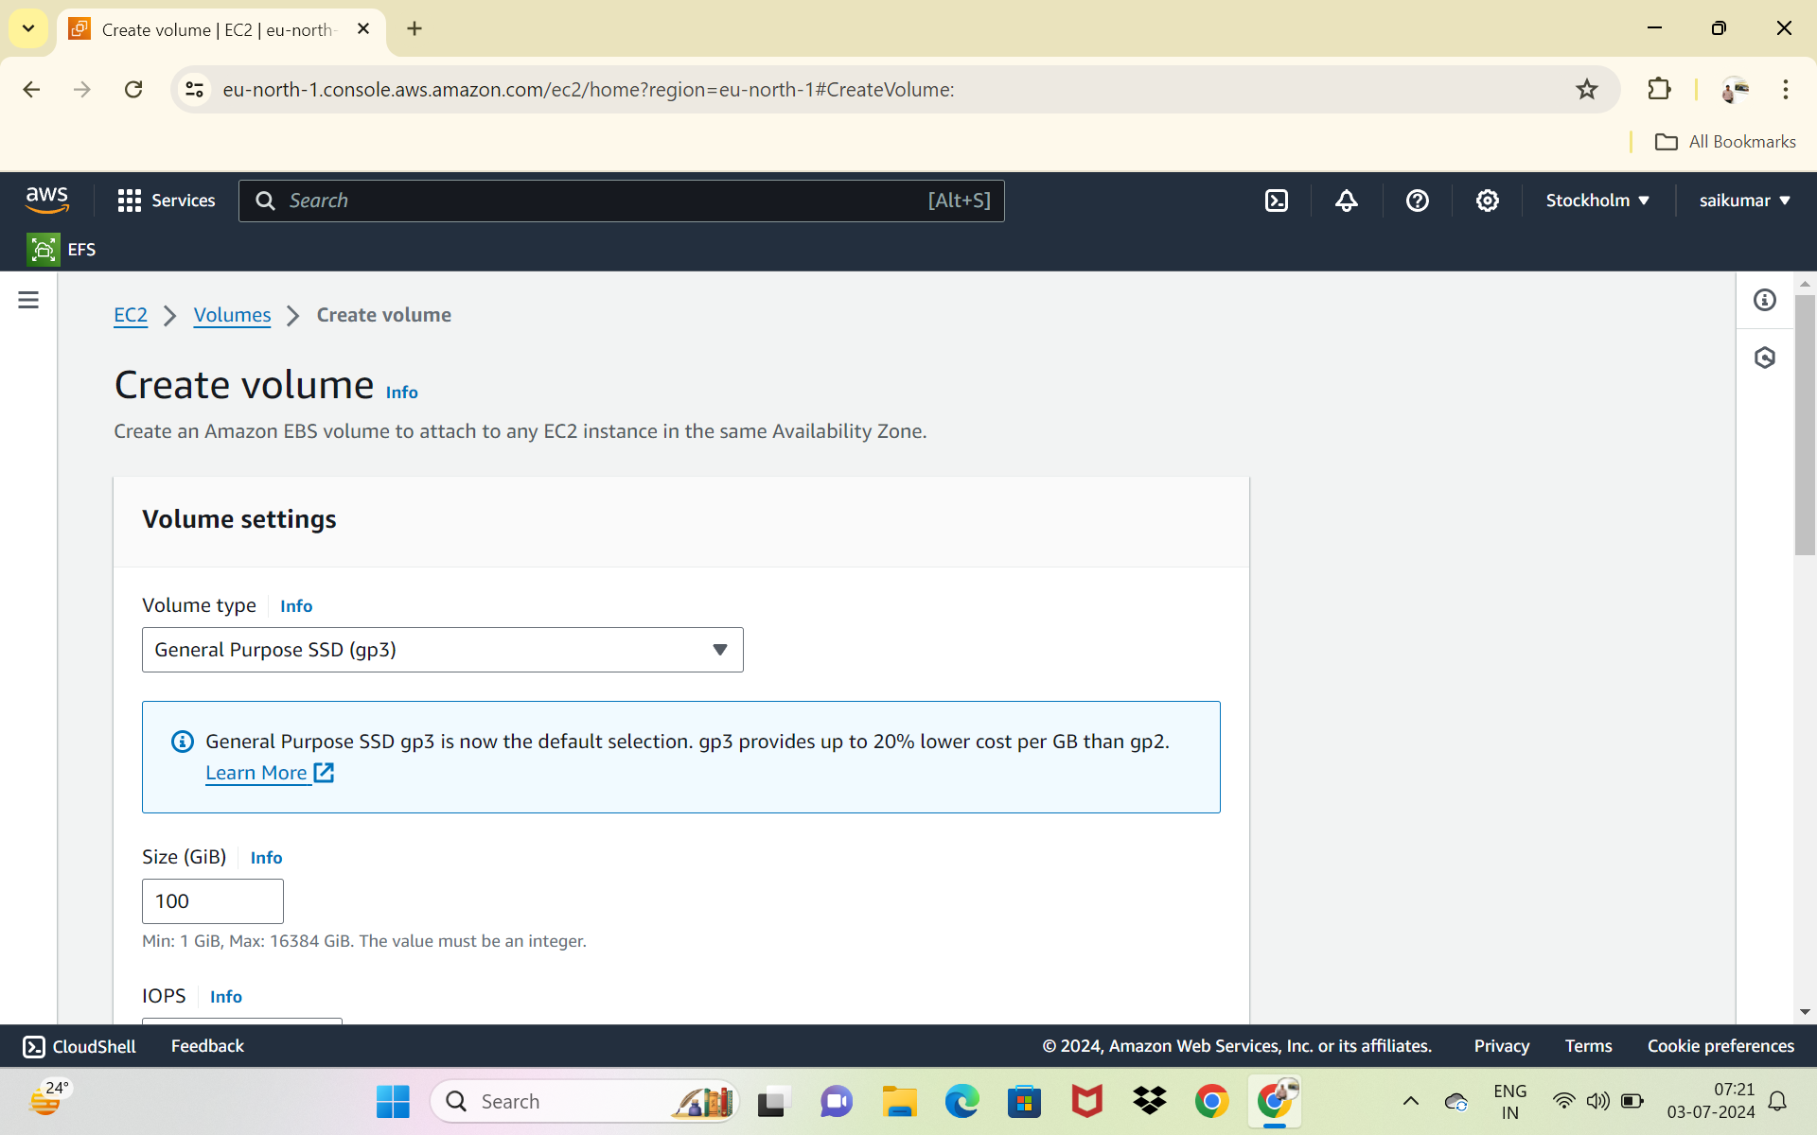
EBS CREATE A VOLUME

Slide 4
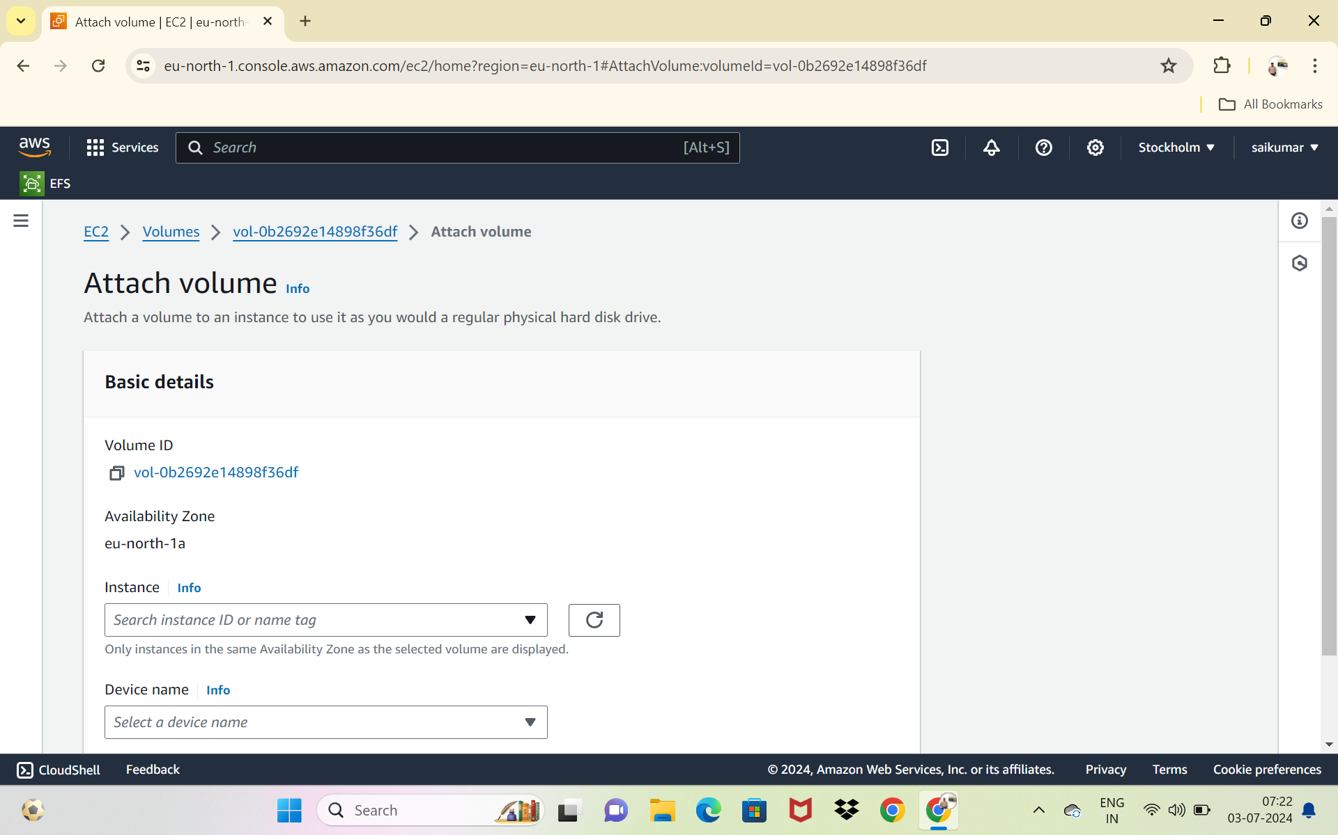
ATTACH VOLUME TO INSTANCE

Slide 5
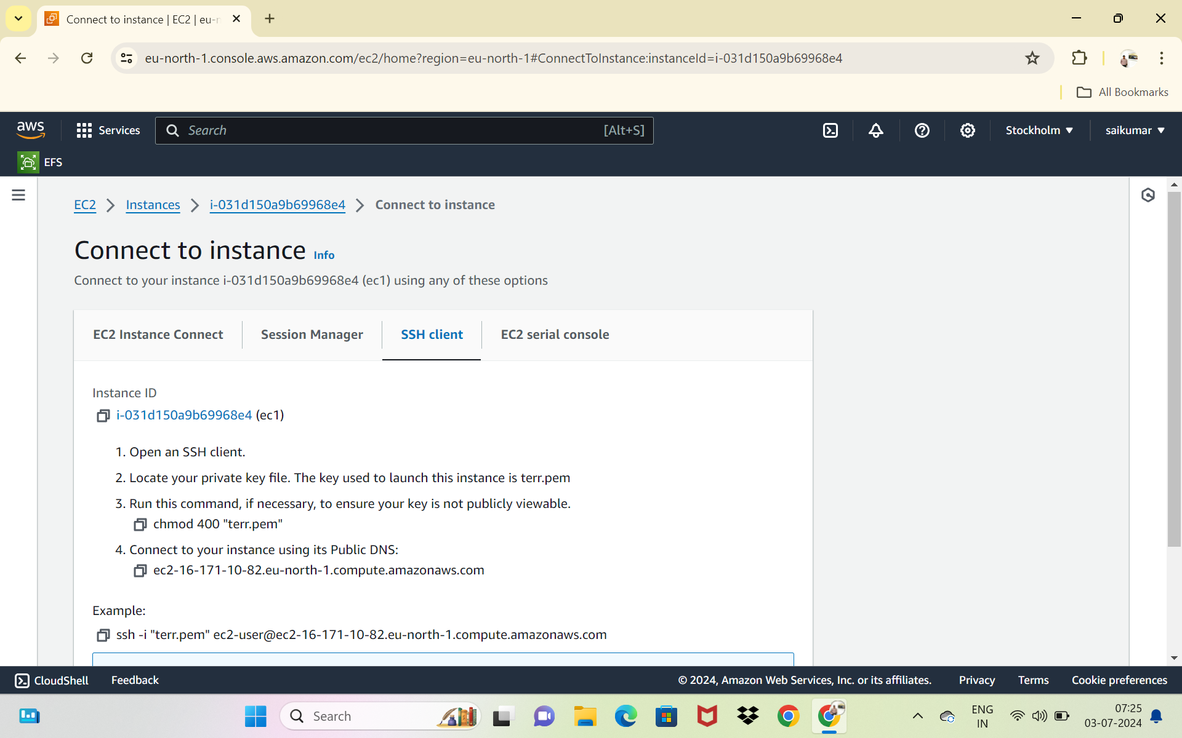
CONNECT TO INSTANCE

Slide 6
Steps :
List the all block device’s in linux
Check if there any file system on this device
Create file system
Check if there any file system on this device
Create a directory
Mount the directory
Check the disk free space

Slide 7
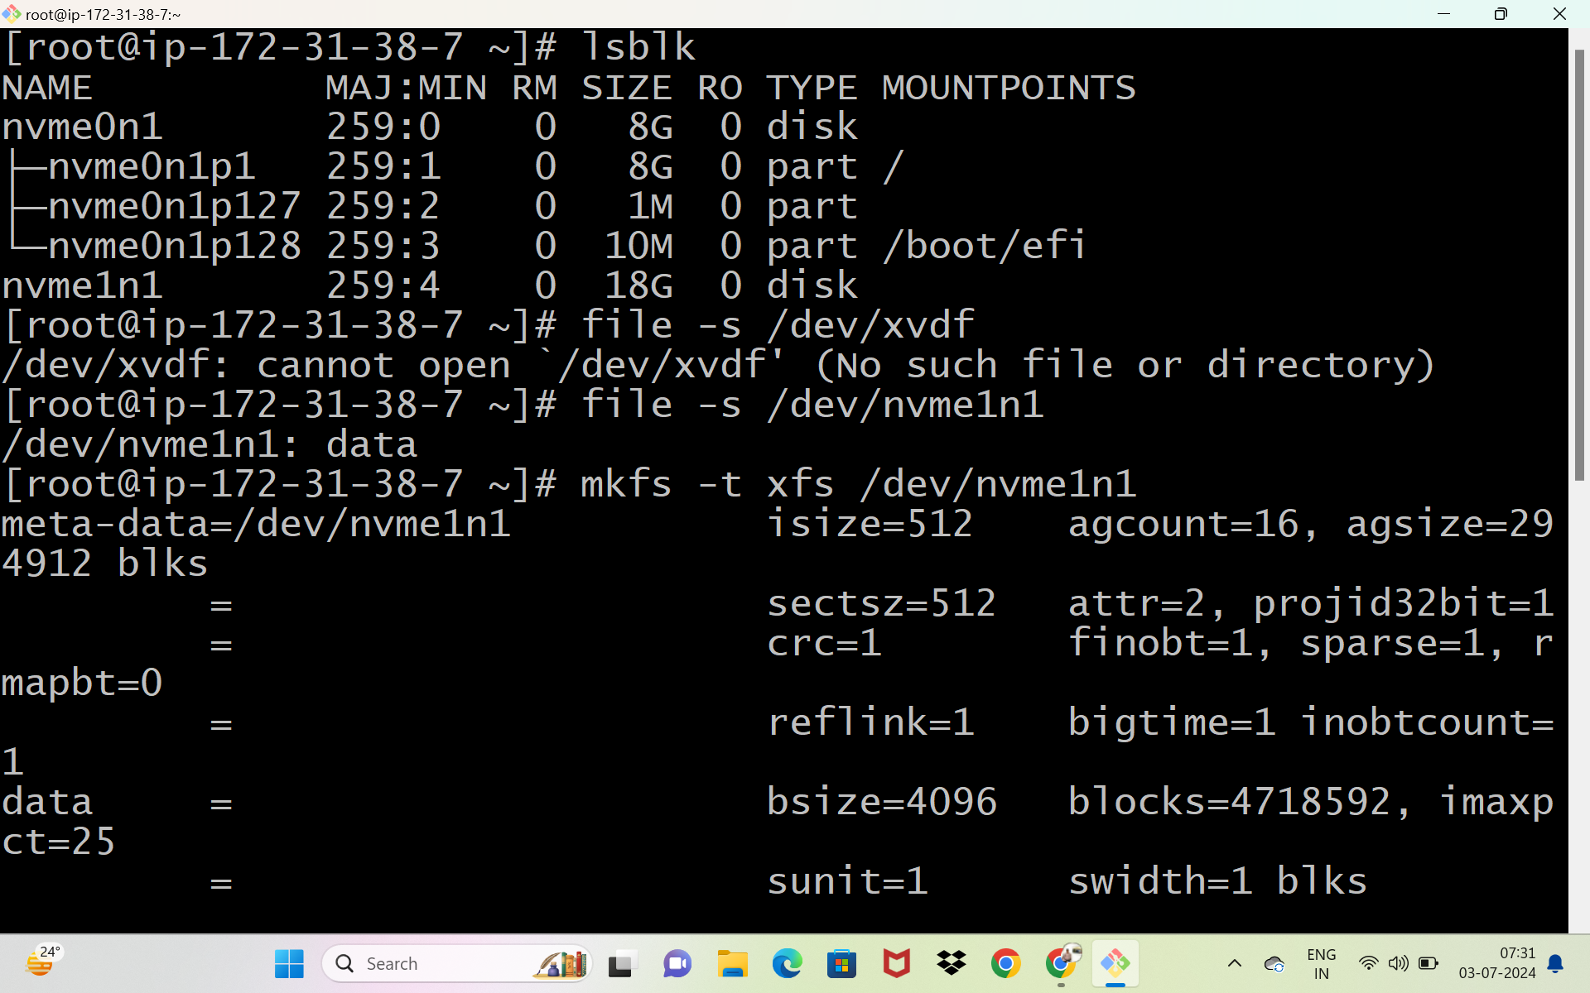

Slide 8
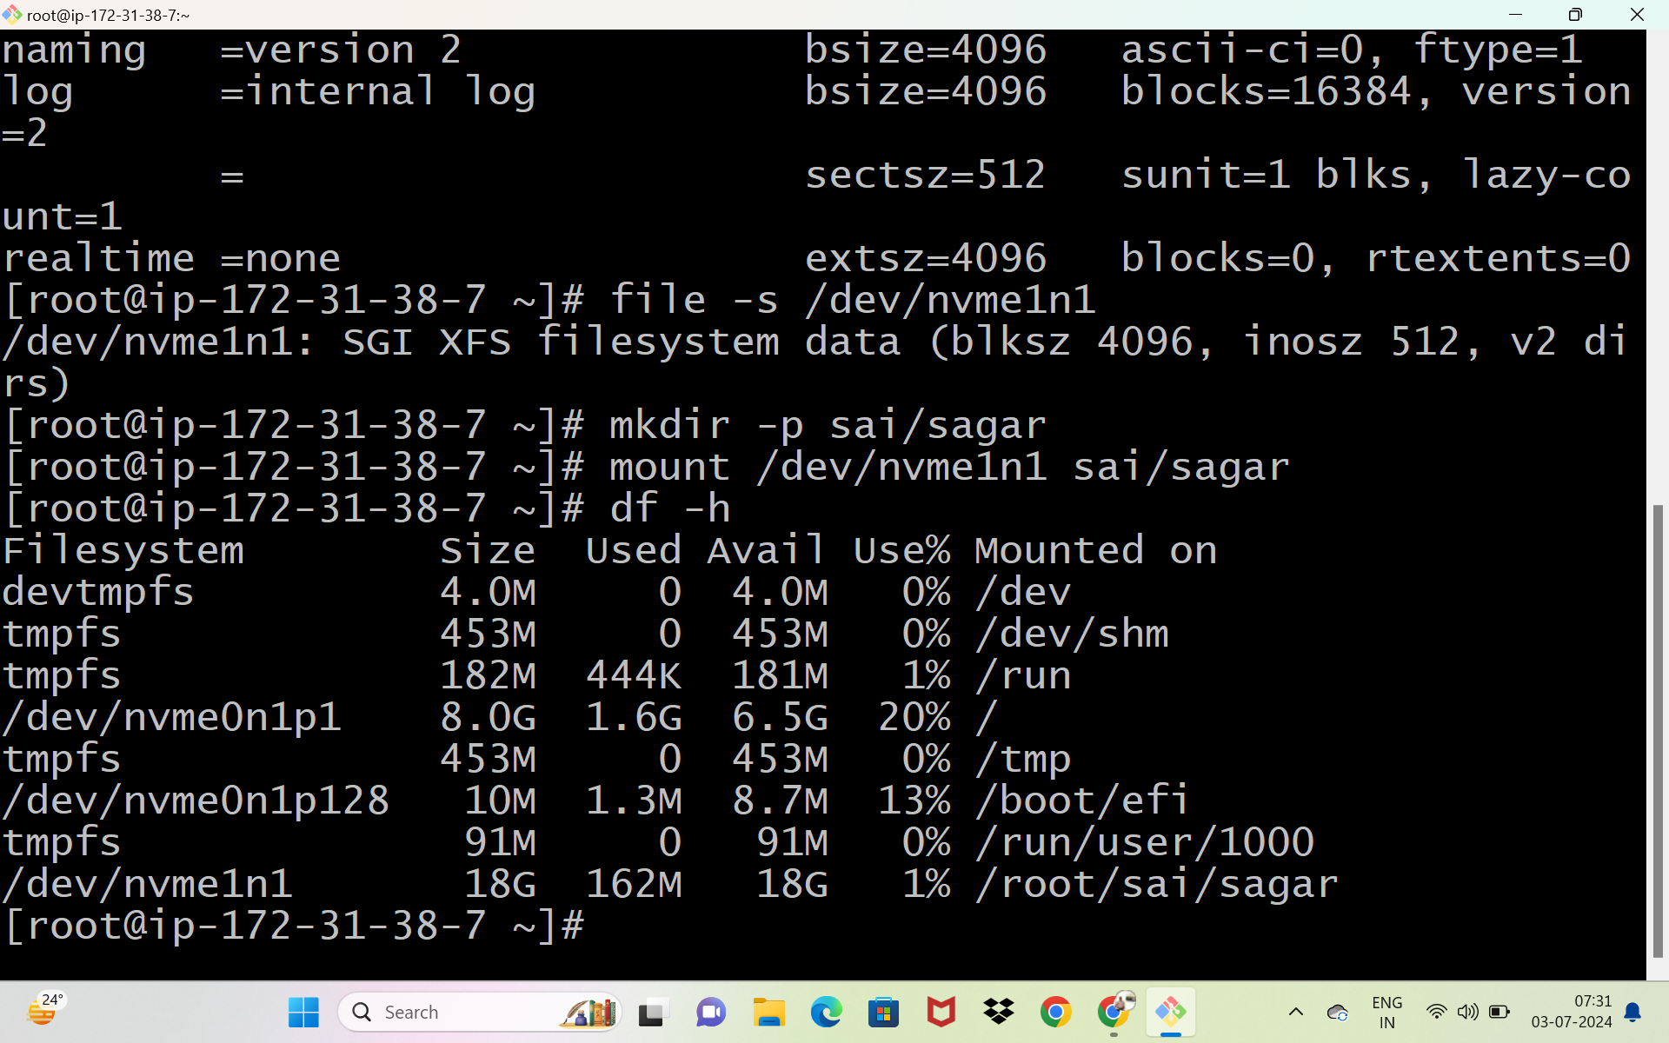

Slide 9
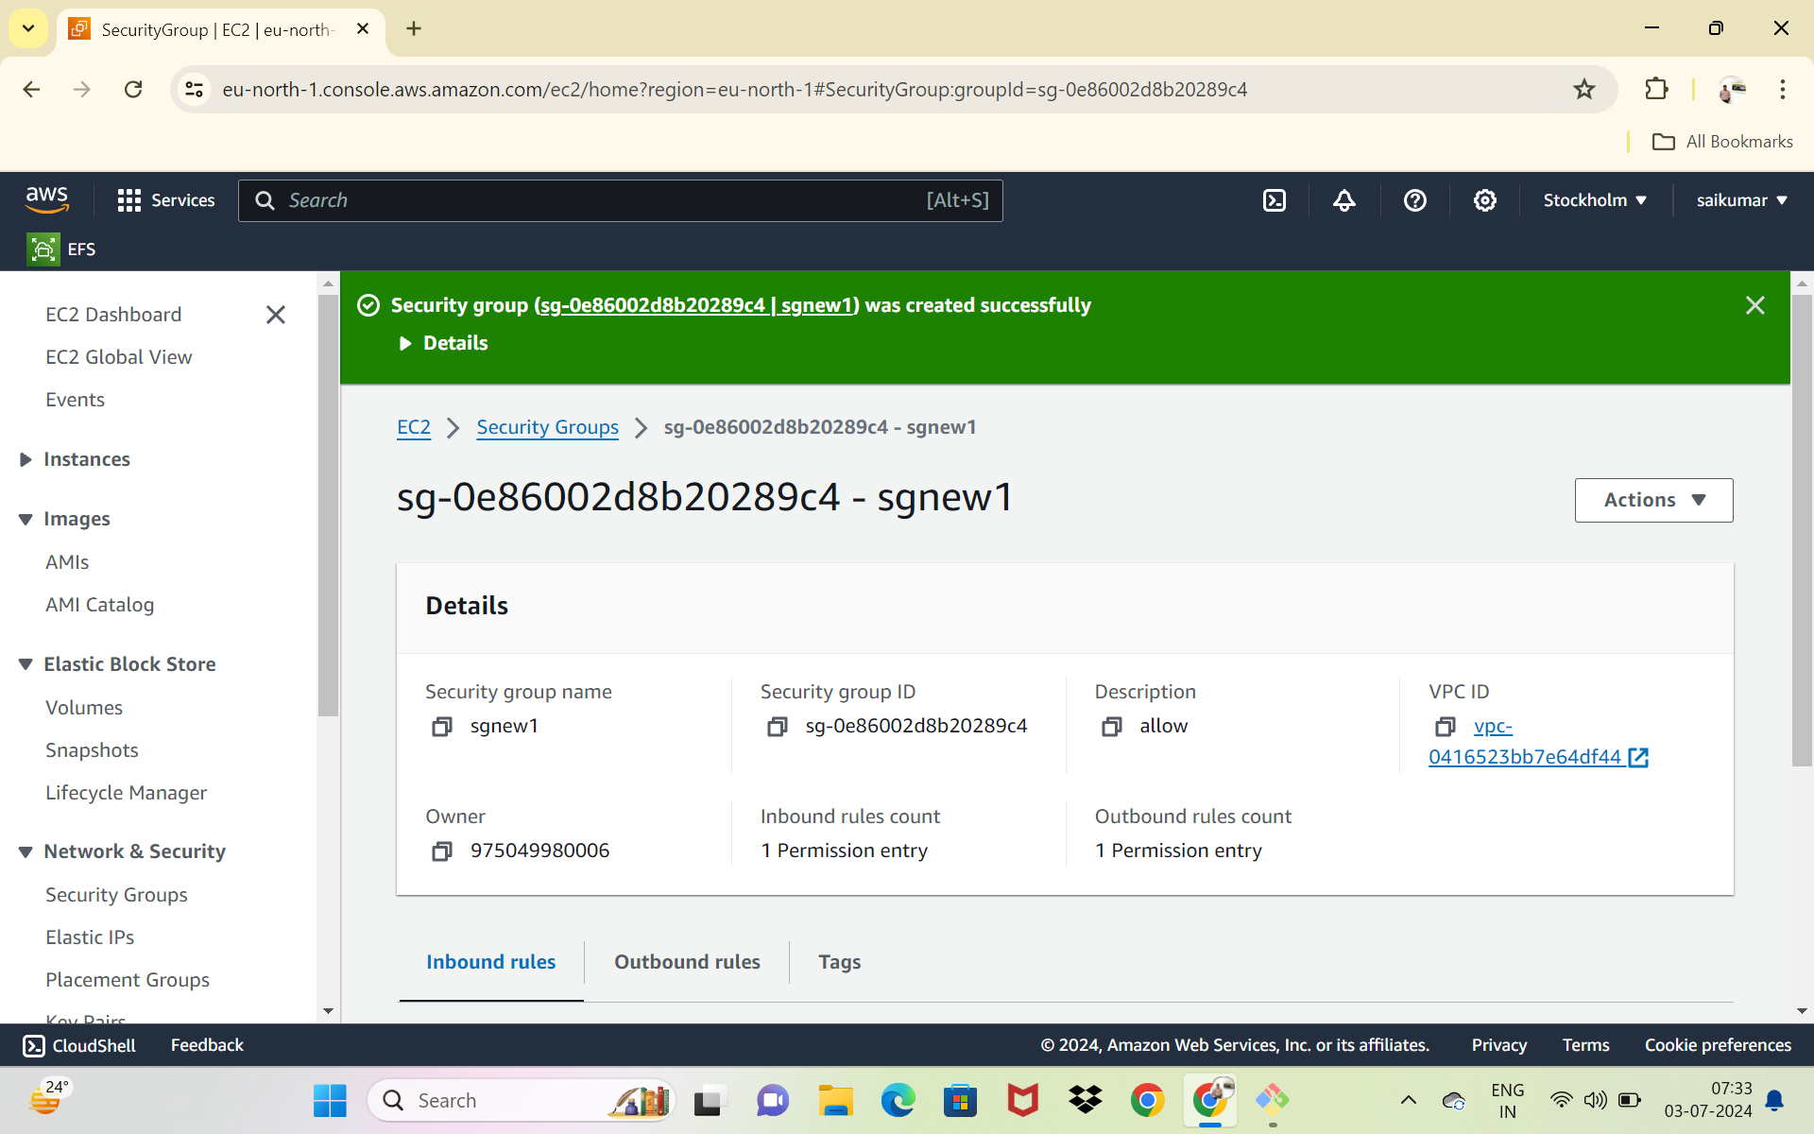
EFS
CREATE A SECURITY GROUP

Slide 10
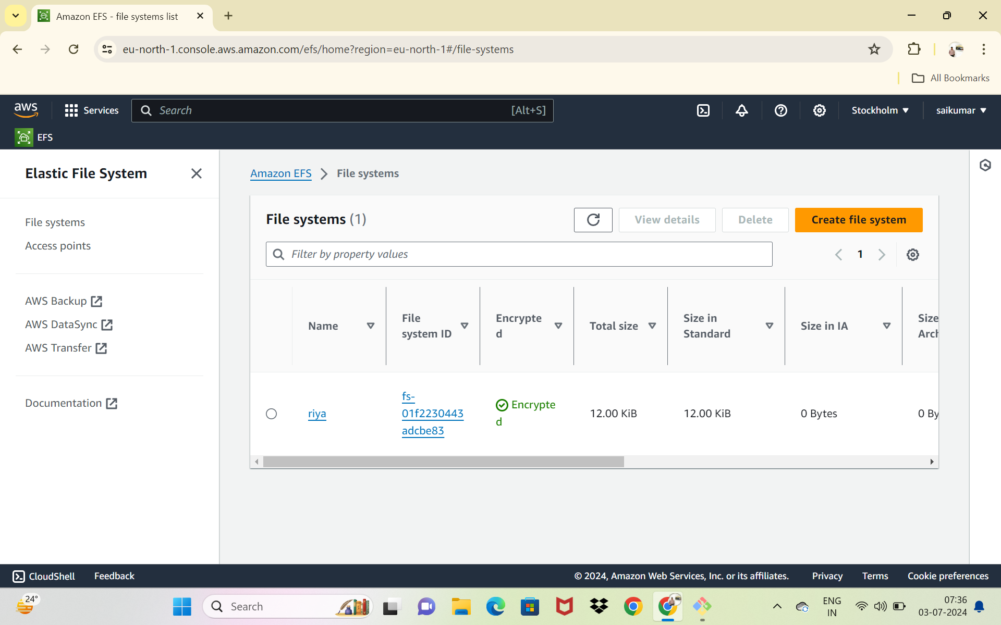
CREATE A EFS FILE SYSTEM

Slide 11
Steps:
Create a file system in one server(instance) ---server1
Store some data in that file system
Create a file system in one server(instance) ---server2
Store some data in that file system
Both server 1 and server 2 contains same file and data these type of data sharing is called elastic file storage (EFS)

Slide 12
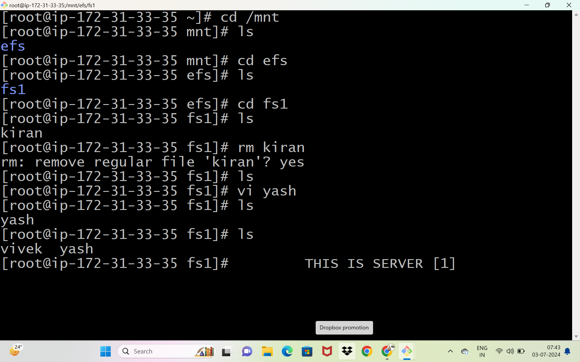

Slide 13
